Slide 1




PROBLEM TREE + 5 WHYs?
HOW TO USE?
BOOTCAMP ONE | DAY TWO
HCD EXERCISE | FOUNDATION
UNDERSTAND THE PROBLEM OR OPPORTUNITY
2
Effects
Note down: The effects and signs that qualify the problem or opportunity.
Objective of Exercise
To establish a primary understanding of the elements of a problem or opportunity. To identify effects and causes that inform the identification of themes / lines of inquiry for research in the Discovery phase.
Tool
Problem Tree + 5 Whys?
About ‘Problem Tree’
The tool has three parts - the Trunk/Core (problem/opportunity), the Branches (effects/signs), and the Roots (causes/reasons). While traditionally the tool is looked only through a problem lens, we can also use it to appreciate opportunities.
About ‘5 Whys?’
A tool that is a series of questions that helps us get to the root cause of something. It is used as a complementary tool to the problem tree.
Effect
Effect
Effect
Effect
Effect
Effect
1
1
Effect
Effect
Effect
Problem or Opportunity
Note down: The main problem or opportunity that you are looking to work on.
Problem
Problem
Problem
Cause
Cause
Cause
Cause
Root Cause
Cause
Cause
Root
Cause
Root Cause
3
Root
Cause
Cause
Causes
Note down: The causes or reasons that make it a problem or an opportunity.
Cause
Root
Cause
Cause
Root
Cause
Root
Cause
*
5 Whys?
To really get into the depth (or root cause/reason) of what makes something a problem or opportunity, we can use the 5 Whys? tool. Keep asking why? until you feel that you have a strong enough root cause.
FINANCIAL INNOVATION LAB | BOOTCAMP ONE

Slide 2
BOOTCAMP ONE | DAY TWO
HCD EXERCISE | FOUNDATION
UNDERSTAND THE PROBLEM OR OPPORTUNITY
Notes
Session Flow
Sharing the Objective | 2 Min
Facilitators to share the objective of the session/exercise.
Walkthrough - Example | 5 Min
Facilitators to walk through 1-2 examples of the tool in use.
Walkthrough - ‘How To?’ | 5 Min
Facilitators to walk through the ‘How to?’ of the tool as per instructions on the toolsheet.
Clarifications | 3 Min
Facilitators to clarify doubts from participants.
Exercise | 30 Min
Participants to use tool with guidance from the facilitation team. A potential flow of the exercise could be -
Team to discuss and agree on exercise - 5 Min
Individual members to note down their cause and effects - 5 Min
Mapping causes and effects and discussion - 10 Min
Root cause + 5 Whys- 10 Min
Points to Consider
The numbering provided in the How To? is a recommended path. Startups may still choose to fill the template as per their convenience.
The problem or opportunity should be something specific that has been chosen to be investigated.
The levels to which the effects and the causes can be mapped have to evolve organically and depending on the understanding of the team. There is no pressure to be exhaustive - it is meant to start the planning process - not to complete the analysis.
Some roots and causes might end at level one, some at two, some at three, and so on. The team has to feel like they are at least capturing broad aspects.
The tool can also be used after research to map the learnings and data - in the form of a mind map/tree diagram.
Tool
Problem Tree + 5 Whys?
Material
Template, Chart Paper, Post-Its, Pens/ Sketch Pens
Time
45 Minutes
FINANCIAL INNOVATION LAB | BOOTCAMP ONE

Slide 3
TOOL: PROBLEM TREE + 5 WHYs?
Effects
Effects
Effects
Effects
Effects
Effects
Effects
Effects
Effects
Problem or
Opportunity
Causes
Causes
Causes
Causes
Causes
Why?
Causes
Why?
Causes
Root Causes
Why?
Causes
Causes
Why?
Root Causes
Root Causes
Root Causes
FINANCIAL INNOVATION LAB | BOOTCAMP ONE

Slide 4
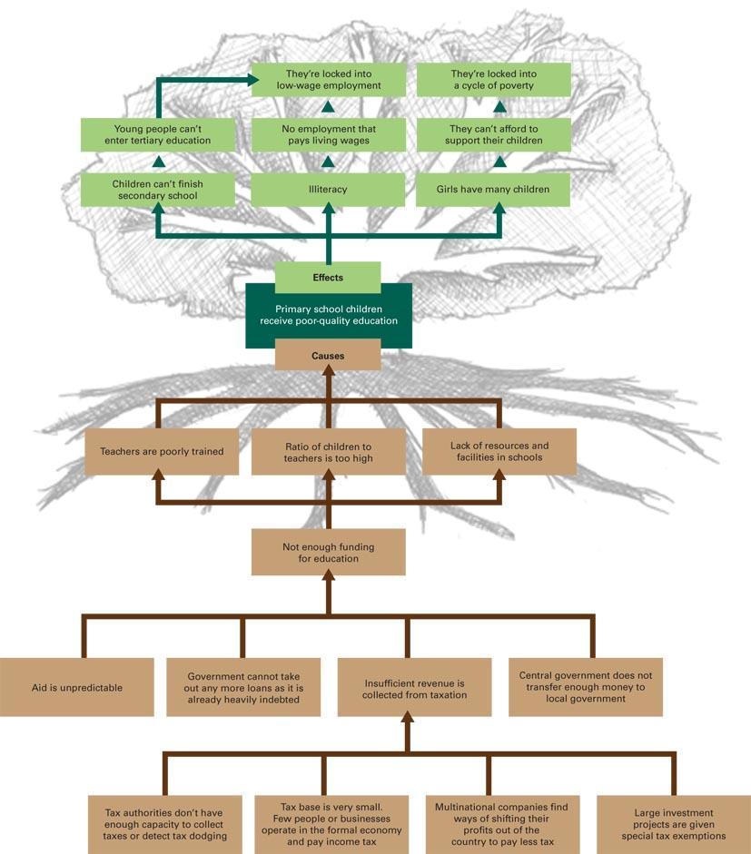
TOOL: PROBLEM TREE + 5 WHYs?
FINANCIAL INNOVATION LAB | BOOTCAMP ONE

Slide 5
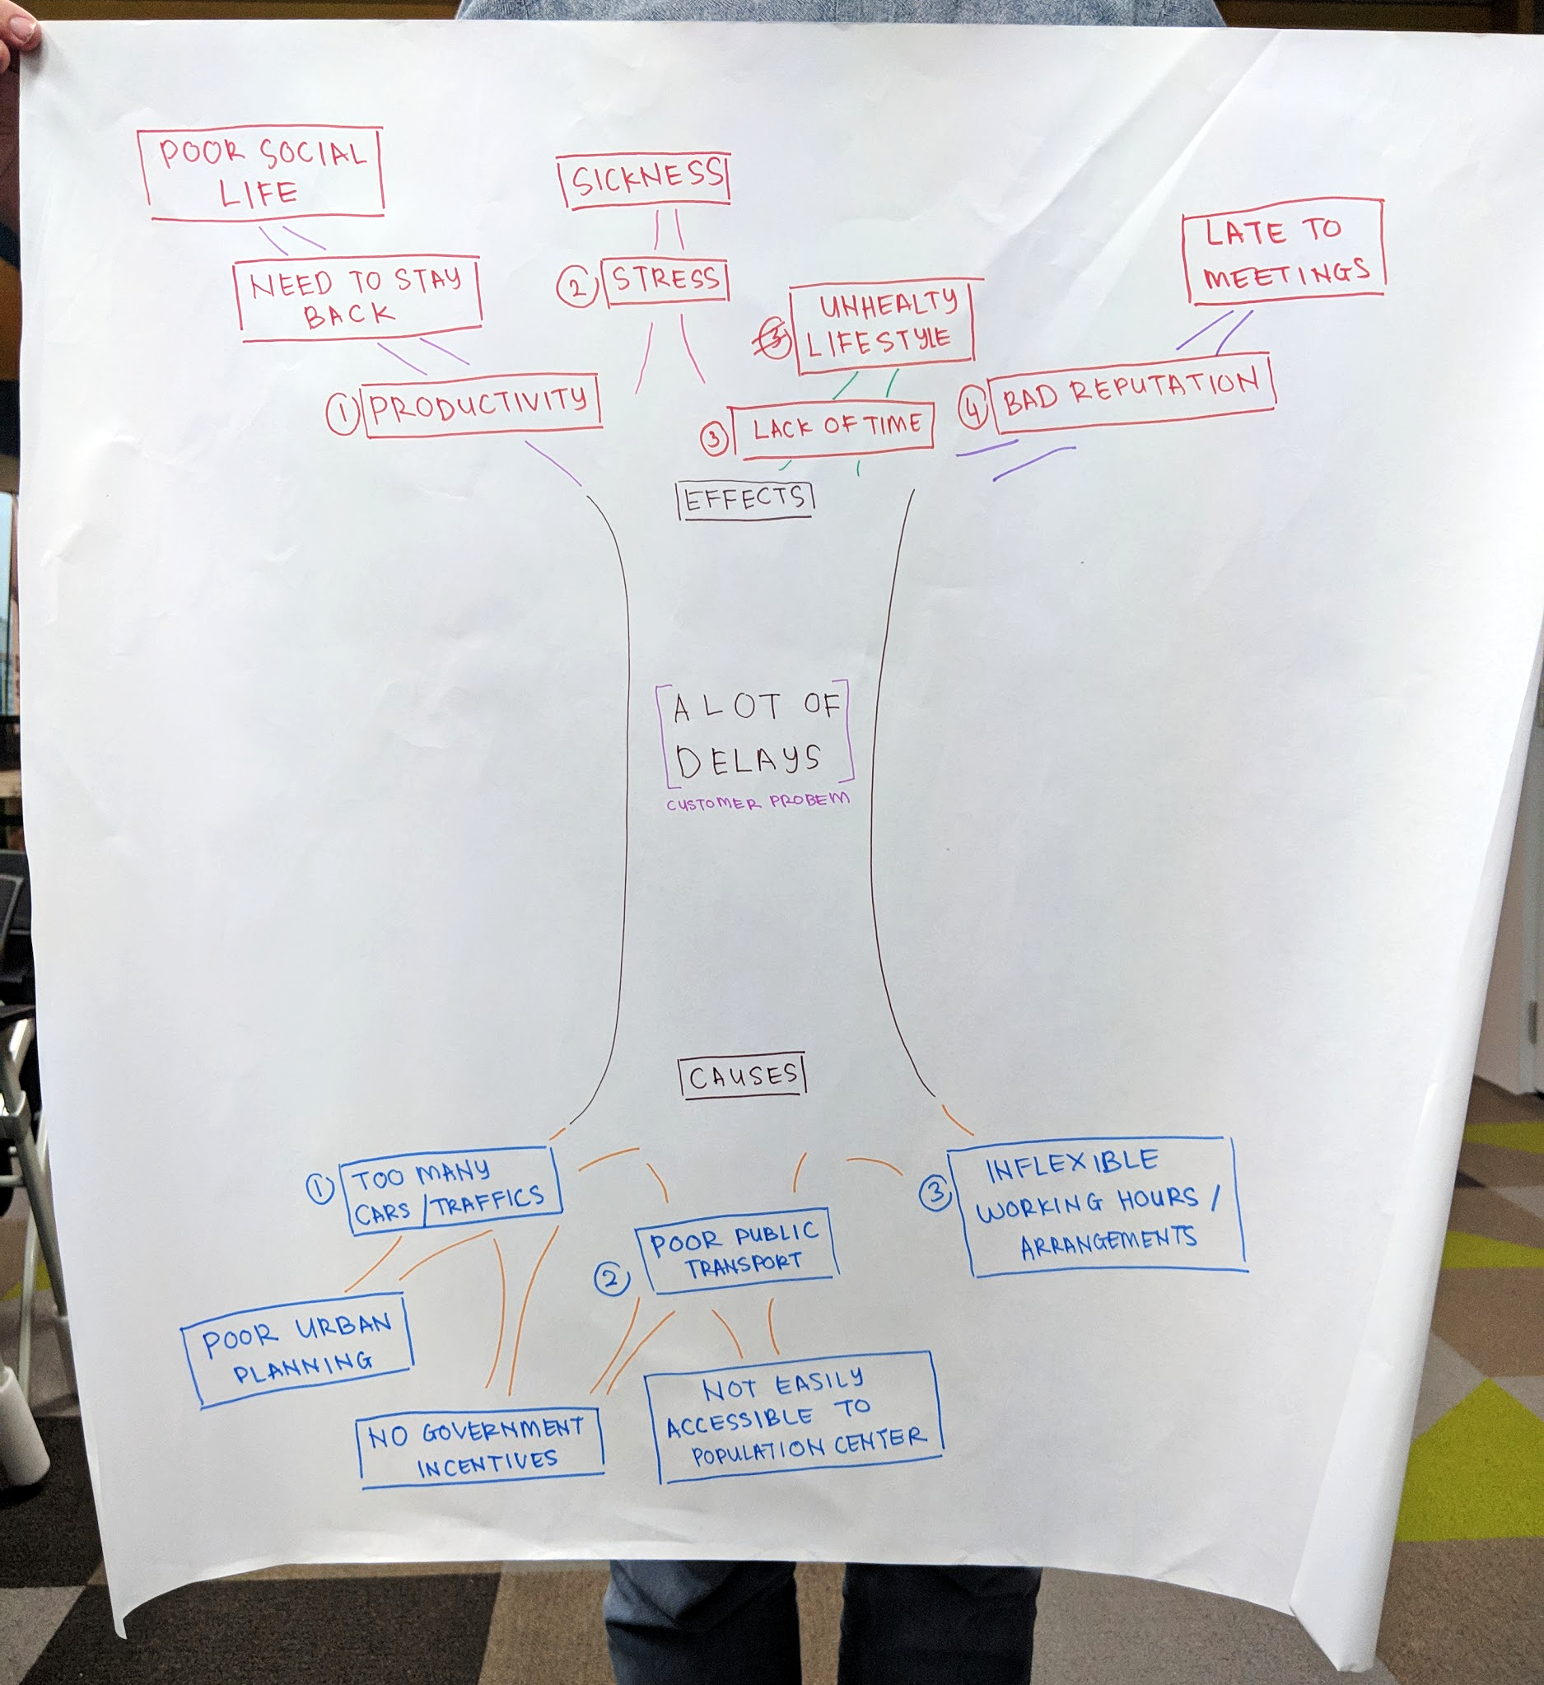
TOOL: PROBLEM TREE + 5 WHYs?
FINANCIAL INNOVATION LAB | BOOTCAMP ONE

